Slide 1
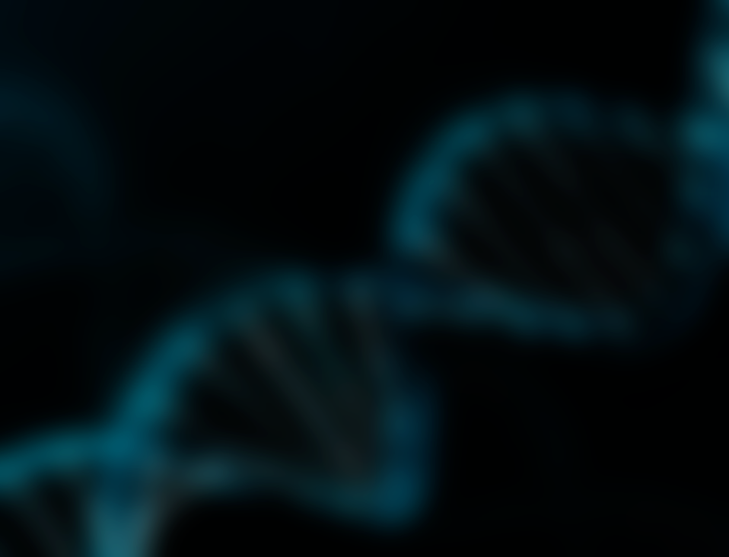
CNBP & Myotonic Dystrophy Type 2
Paxton Paine

Slide 2
What is myotonic dystrophy type 2 (DM2)?
DM2 is the most common muscular dystrophy found in adults

Slide 3
What are the symptoms of DM2?
Muscle pain, wasting, and weakness
Heart problems
Myotonia
And many more…

Slide 4
What is CNBP?
Biological Process Regulation of transcription Molecular Function Metal/zinc ion binding Nucleic acid binding Cellular Component Cytosol Endoplasmic reticulum Nucleus
Notes:
G-Quadruplex on 4000 mrnas

Slide 5
Is CNBP conserved across species?
Yes!

Slide 6
What causes DM2?
CCTG sequence repeats within first intron of CNBP causes DM2

Slide 7
Gaps in knowledge
Effect of diminished CNBP levels?
Dysregulation from toxic mRNA?
Notes:
https://www.google.com/url?sa=i&rct=j&q=&esrc=s&source=images&cd=&cad=rja&uact=8&ved=2ahUKEwiDieHexqHaAhXs44MKHdKEAxwQjhx6BAgAEAM&url=http%3A%2F%2Fwww.gentegra.com%2F&psig=AOvVaw1qxQYq6YAyruBEhFoRNEnI&ust=1522963318851078

Slide 8
What model organisms should be used?
CNBP mutated Drosophila melanogaster exhibits a muscle wasting phenotype and similar molecular defects

Slide 9
What is the primary goal?
To understand how low CNBP and toxic mRNA contribute to muscle wasting & myotonia
Aim 1
Aim 2
Aim 3
Identify conserved amino acids important in binding skeletal muscle transcripts
Identify differentially expressed skeletal muscle mRNAs
Notes:
https://www.google.com/url?sa=i&rct=j&q=&esrc=s&source=imgres&cd=&cad=rja&uact=8&ved=2ahUKEwiAruaEzqTaAhWryoMKHSVLDKwQjhx6BAgAEAM&url=https%3A%2F%2Fen.wikipedia.org%2Fwiki%2FZinc_finger&psig=AOvVaw21B6_cVqtdvVOJFJlJZCtA&ust=1523068391032367
https://www.google.com/url?sa=i&rct=j&q=&esrc=s&source=images&cd=&cad=rja&uact=8&ved=2ahUKEwjTk8XfzqTaAhVN1IMKHb67A8UQjhx6BAgAEAM&url=https%3A%2F%2Fwww.videoblocks.com%2Fvideo%2Fbar-graph-up-and-down-line-drawing-illustration-animation-with-transparent-background-rxc8sbuzgivj98fum&psig=AOvVaw2we4zfI020ggUhn3MAqAPq&ust=1523068492749715

Slide 10
Aim 1: Identify conserved aa’s binding skeletal muscle transcripts
1) Identify conserved protein domains using SMART

Slide 11
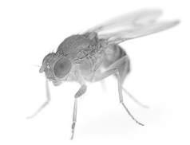
Aim 1: Identify conserved aa’s binding skeletal muscle transcripts
2) Mutate conserved amino acids using CRISPR

Slide 12
Aim 1: Identify conserved aa’s binding skeletal muscle transcripts
Hypothesis: At least one ZnF domain will be critical to the regulation of skeletal muscle genes
3) Screen for muscle wasting phenotype
Notes:
https://www.google.com/url?sa=i&rct=j&q=&esrc=s&source=images&cd=&cad=rja&uact=8&ved=2ahUKEwjTptW80qTaAhUJ_4MKHUi4CugQjhx6BAgAEAM&url=http%3A%2F%2Fwww.sdbonline.org%2Ffly%2Fatlas%2F41.htm&psig=AOvVaw0-Sp0Mbd-Szx29Euylf2JY&ust=1523069580401601

Slide 13
Aim 2: Identify differentially expressed skeletal muscle mRNAs
1) Perform RNA-seq on WT and mutant CNBP in muscle tissue

Slide 14
Aim 2: Identify differentially expressed skeletal muscle mRNAs
2) Sort genes using gene ontology

Slide 15
Aim 2: Identify differentially expressed skeletal muscle mRNAs
Hypothesis: Genes with large variations in expression will be related to muscle wasting pathways
3) Knock-out differentially expressed transcripts with CRISPR

